Slide 1
MULTIPLE VIRTUAL STORAGE
BY
VADDI SATYA SRI
EMP-ID: 46299532

Slide 2

CONTENTS
Introduction
Multiple Virtual Storage
MVS Evolution
Data processing
Command processing
Input /Output Devices

Slide 3
INTRODUCTION
A mainframe is a large-capacity computer system with processing power that is significantly superior to PCs .
It has been there in the Software Industry for more than 40 years
No new technology can totally replace Mainframes because of its architecture and efficiency

Slide 4
How do mainframe work ?
IBM mainframes are uniquely designed to…
Run specialized operating systems such as IBM z/OS®, and software that takes advantage of unique hardware capabilities.
Support massive simultaneous transactions and throughput (I/O) with built-in capacity on demand and built-in shared memory for direct application communication.
For instance, the latest IBM zSystems® mainframes can execute up to 1 trillion secure web transactions per day and manage privacy by policy.

Slide 5
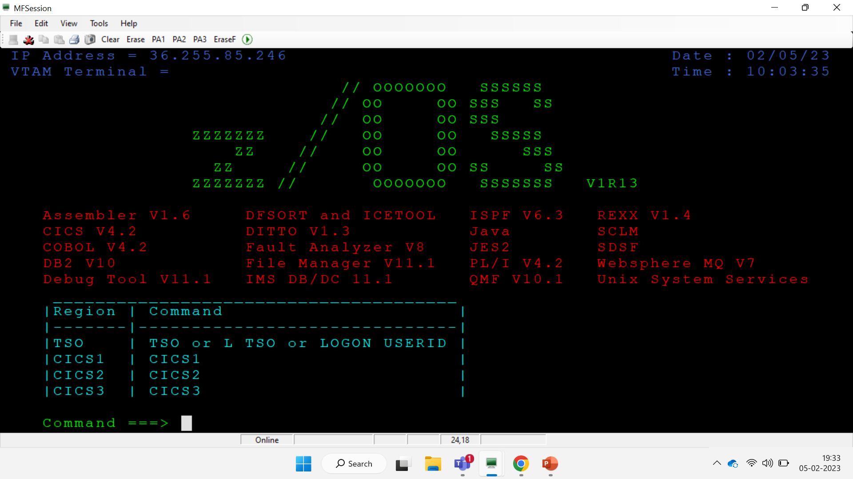

Slide 6
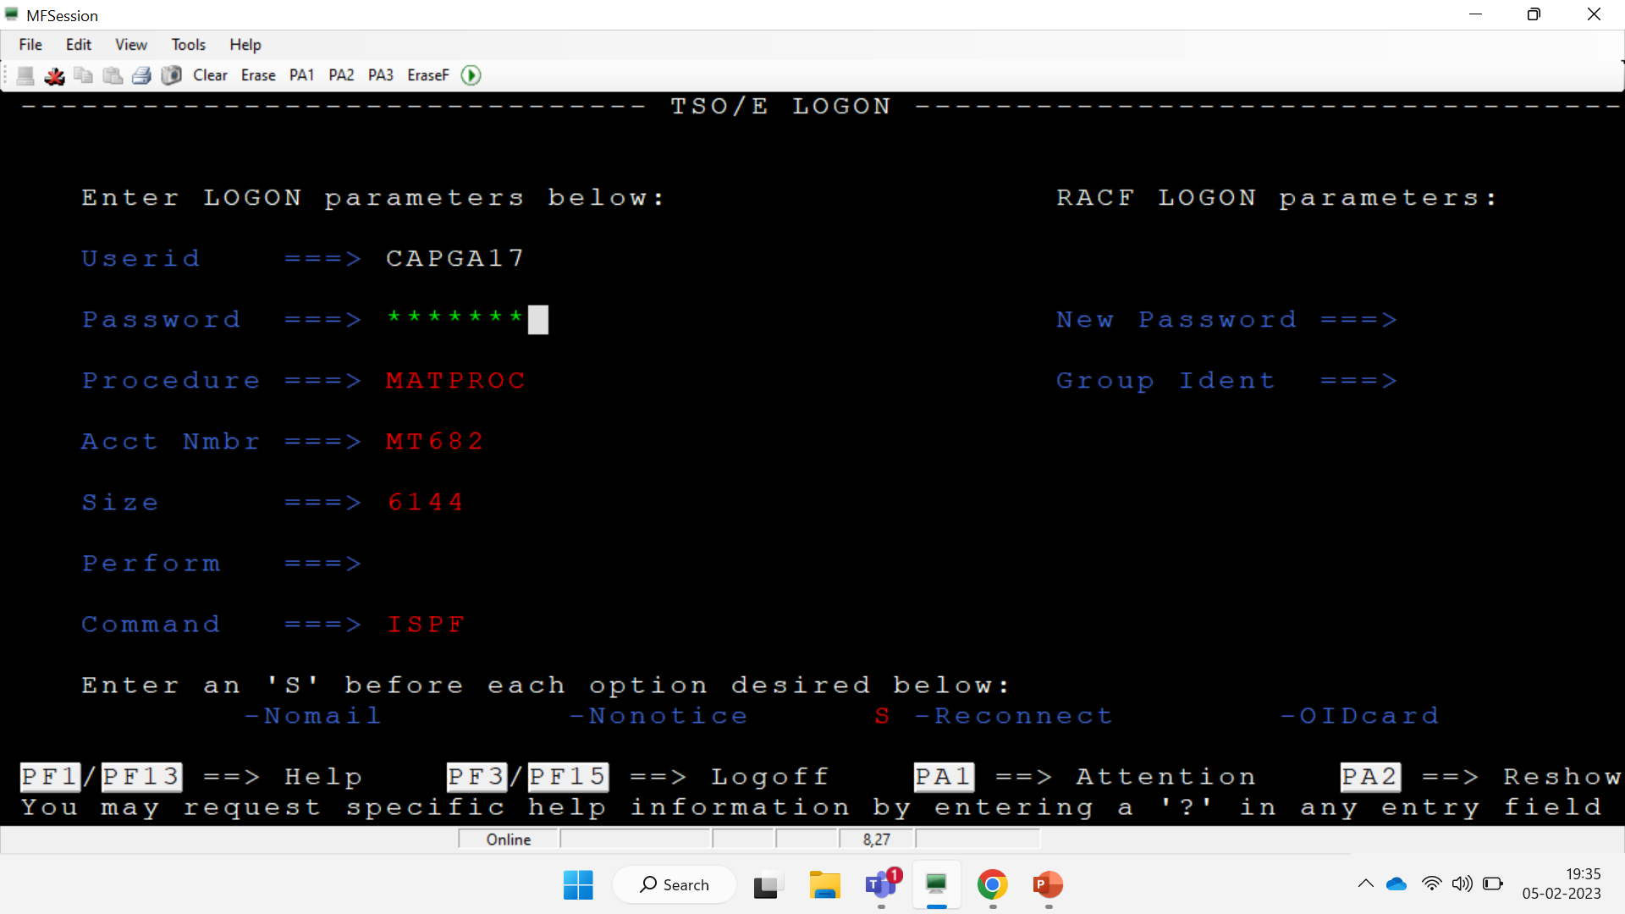

Slide 7

Multiple Virtual Storage
MVS is IBM’s most powerful operating system for mainframe computers.
Earlier it was known as IBM mainframe operating system.
Today it is called as Multiple Virtual Storage (MVS)
It is basically used for huge application and to support large databases.

Slide 8
MVS Evolution
Multiple virtual storage was introduced in 1974.
MVS evolved from OS/360, the operating system for the System/360, which was released in 1964.
A more recent evolution of MVS is z/OS, an operating system for IBM’s Z Series mainframes.

Slide 9
The main user interface in MVS systems is TSO (Time Sharing Option).
The Interactive System Productivity Facility (ISPF) is a set of menus for compiling and managing programs and for configuring the system.

Slide 10
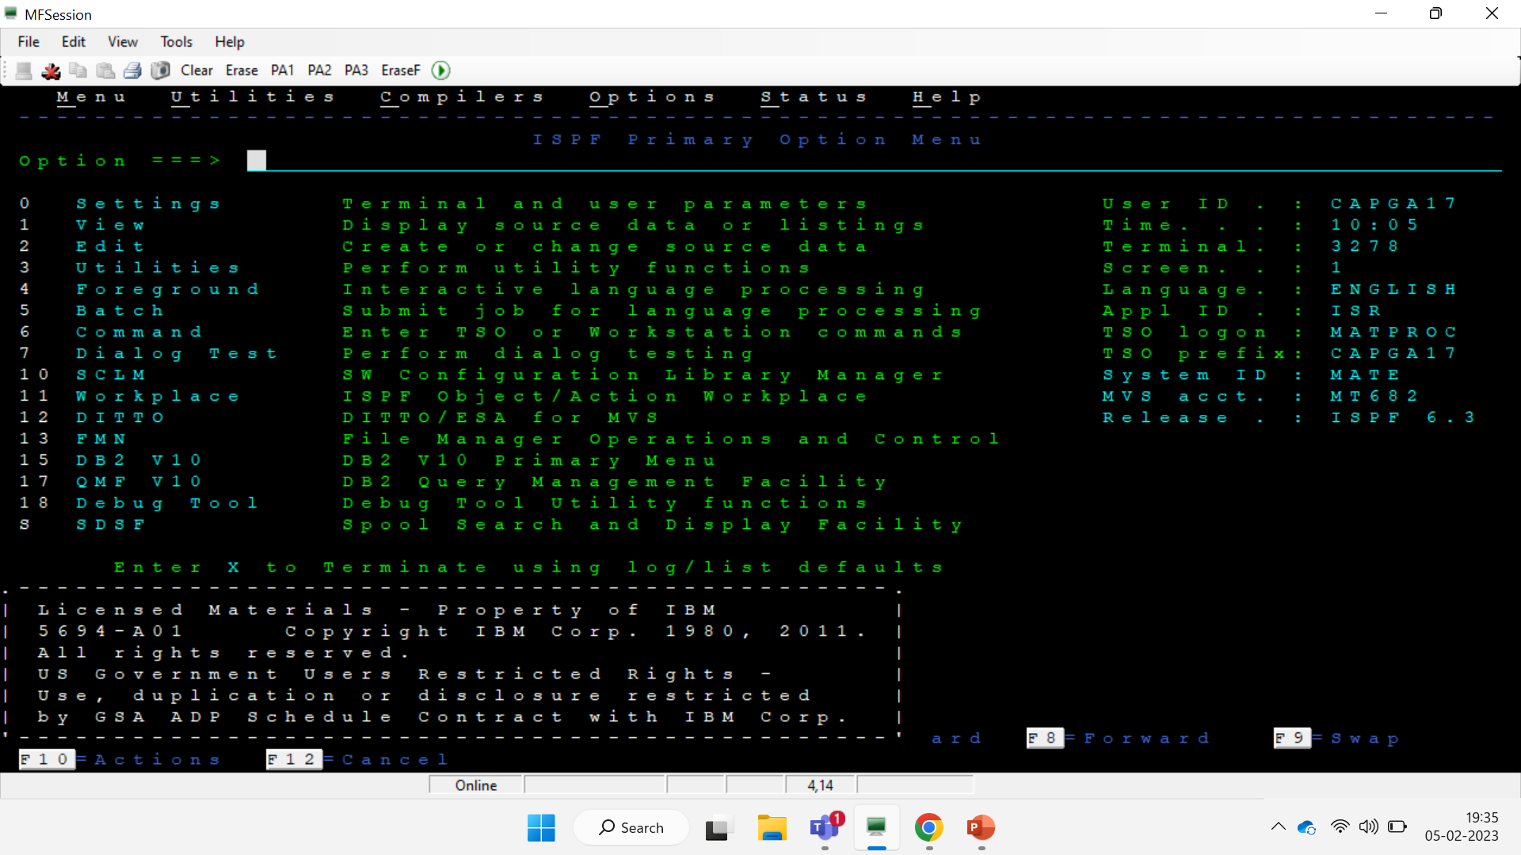

Slide 11
Data Processing in MVS
On-Line Mode / Foreground Mode:
It provides an interactive mode for the end user to execute the application programs.
Batch Mode / Background Mode:
It provides a non-interactive mode for executing the programs.
Programs are normally submitted as batch job for execution.

Slide 12
Command Processing in MVS
Command Issue Mode:
How a user (programmer / end-user) interacts with the computer
For example: To edit a program, to execute a program in online and batch mode.
Command Execution Mode:
Foreground: Terminal is locked while the command is being executed.
Background: Terminal is free while the command is being executed.

Slide 13
Input/Output Devices
Unit record devices
Magnetic tape devices
Direct Access Storage Devices (disks)
Telecommunication devices

Slide 14


